Slide 1
CONFORMAL TRANSFORMATION
By: 1DT19CS023, Aryan

Slide 2
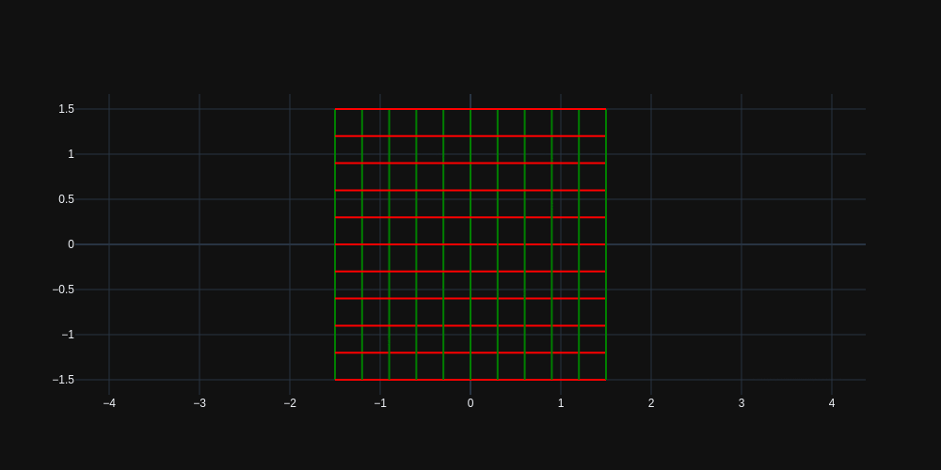
Conformal Mapping ?
A conformal map is a function which preserves the angles.
More formally, a map $w=f(z)$ is called conformal (or angle-preserving) at $z_{0}$ if it preserves oriented angles between curves through $z_{0}$, as well as their orientation, i.e. direction.
$$w=e^{z}$$

Slide 3

Conformal mapping-based 3D face recognition
Face is potentially the best biometrics for people identification related applications for its non instructiveness, contactless and socially well acceptance.
The proposed approach makes use of conformal UV parameterization for mapping purpose and Shape Index decomposition for similarity measurement.

Slide 4
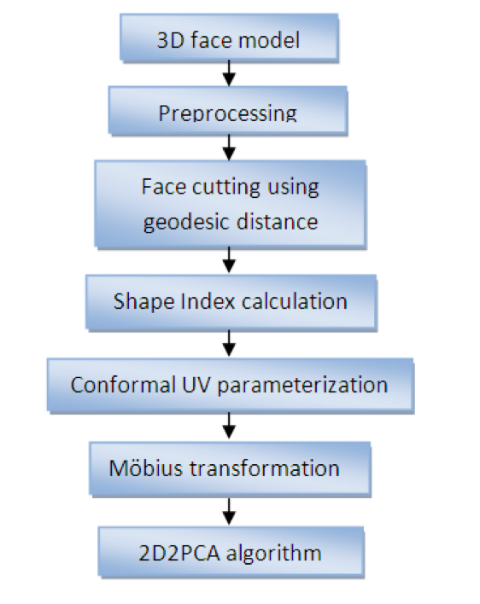
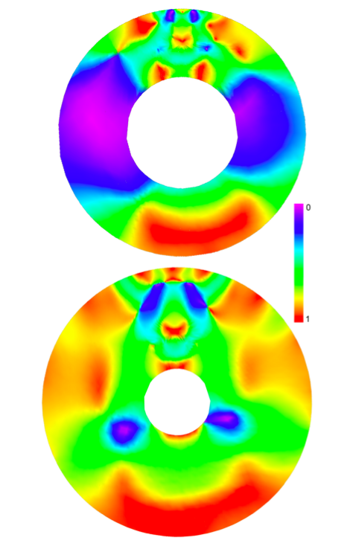
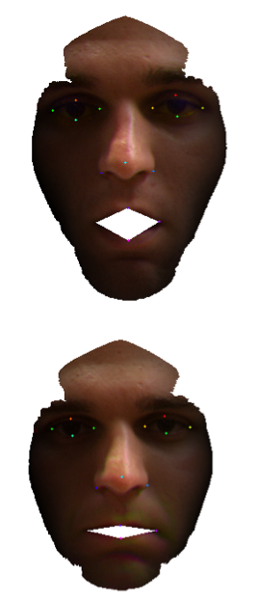
Flowchart
Conformal Map created from parametrized UV coordinates, colors represent Shape Index value. The mouth part has been mapped to the inner hole while outer face boundary to the boundary of circle.
Geodesic face cutting result with zero distance
between lips in presence
of expression.
Rasterized images are used as an input for $(2D)^{2}PCA$ recognition algorithm.

Slide 5
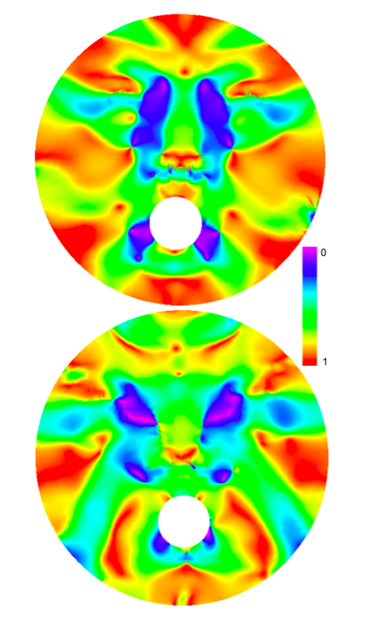


What about Facial Expressions ??
Möbius Transformation carried on UV conformal coordinates.
Following formula is used : $f(θ,z_{0},z)=e^{iθ}\frac{(z-z_{0})}{1-{\overset{˜}{z}}_{0}z}$,
where $z=(u+iv)$ complex number within unit disk.
$θ,z_{0}$ and $z$ are parameters.
Conformal maps transformed by Möbius
Transformation with centre point in the nose tip
🤔😂🥲😘😜😋☹️😡😐🙄

Slide 6
Thank You

Slide 7
Maths Creative assessment Name:Azeem Husain Khan USN:1DT19CS024
Module : Joint probability distributions

Slide 8
Joint Probability Distribution:
In general, if X and Y are two random variables, the probability distribution that defines their simultaneous behavior is called a joint probability distribution.
For example: X : the length of one dimension of an injection- molded part, and Y : the length of another dimension.
We might be interested in P(2.95 < X < 3.05 and 7.60 <Y <7.80)

Slide 9
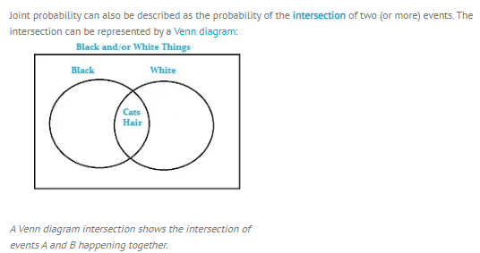
Joint Probability Distribution:

Slide 10
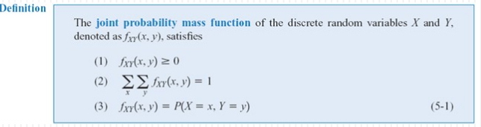
Joint Probability Distribution:
The joint probability distribution of two random variables =bivariate probability distribution.
The joint probability distribution of two discrete random variables is usually written as P(X=x, Y=y).

Slide 11

Application of Joint probability Distribution Examples of Real Life Joint probability distribution : 1. Analysts: Use joint probability as a tool when two or more observable events can occur simultaneously . 2. Sports Strategies : ex : A cricket coach evaluates a player's batting and bowling capability by taking his average performances in previous matches before placing him in the lineup.

Slide 12
Thank you

Slide 13
APPLICATION OF CORRELATION AND REGRESSION
PRESENTED BY: BANU PRIYA B NAIK
1DT19CS025

Slide 14
CORRELATION AND REGRESSION
Correlation analysis is a form of statistics that helps to determine the relationship between two variables where a high correlation indicates a strong relationship, and a weak correlation indicates that they are not closely related.

Slide 15
APPLICATION OF CORRELATION AND REGRESSION:
Basic examples of correlation can be seen around us in our daily lives when we say that the demand and price of a commodity are correlated, or the amount of rainfall and crop output of an area are correlated.
An important aspect is that when the price of the commodity goes up, and its demand goes down; they are negatively correlated.
On the other hand, when the rainfall received in a region is high, and its crop production increases; they are said to be positively correlated.
In general, the value of r lies in a range between -1 to 1; and we can say that if the value of r is such that:
1>r>0, positive correlation exists
r=0, no correlation exists-1<r<0
negative correlation exists

Slide 16
APPLICATION OF LINEAR REGRESSION IN BUSINESS
Businesses often use linear regression to understand the relationship between advertising spending and revenue.
For example, they might fit a simple linear regression model using advertising spending as the predictor variable and revenue as the response variable. The regression model would take the following form:
revenue = β0 + β1(ad spending)
The coefficient β0 would represent total expected revenue when ad spending is zero.

Slide 17
The coefficient β1 would represent the average change in total revenue when ad spending is increased by one unit (e.g. one dollar).
If β1 is negative, it would mean that more ad spending is associated with less revenue.
If β1 is close to zero, it would mean that ad spending has little effect on revenue.
if β1 is positive, it would mean more ad spending is associated with more revenue.
Depending on the value of β1, a company may decide to either decrease or increase their ad spending.

Slide 18
APPLICATION OF LINEAR REGRESSION IN MEDICAL RESEARCHES:
Medical researchers often use linear regression to understand the relationship between drug dosage and blood pressure of patients.
For example, researchers might administer various dosages of a certain drug to patients and observe how their blood pressure responds. They might fit a simple linear regression model using dosage as the predictor variable and blood pressure as the response variable. The regression model would take the following form:

Slide 19
blood pressure = β0 + β1(dosage)
The coefficient β0 would represent the expected blood pressure when dosage is zero.
The coefficient β1 would represent the average change in blood pressure when dosage is increased by one unit.
If β1 is negative, it would mean that an increase in dosage is associated with a decrease in blood pressure.
If β1 is close to zero, it would mean that an increase in dosage is associated with no change in blood pressure.
If β1 is positive, it would mean that an increase in dosage is associated with an increase in blood pressure.
Depending on the value of β1, researchers may decide to change the dosage given to a patient.

Slide 20
CONCLUSION:
Linear regression is used in a wide variety of real-life situations across many different types of industries. Fortunately, statistical software makes it easy to perform linear regression.

Slide 21


